Slide 1



School of Computing
Vel Tech Rangarajan Dr. Sagunthala R&D Institute of Science and Technology
Department of Computer Science and Engineering
10211CS224 / FULL STACK APPLICATION DEVELOPMENT (JAVA)
PROJECT REVIEW : MILESTONE PROJECT – 1
Date: 23-03-2026
Responsive E-Commerce Interface with State-Persistent Cart
SDG: SDG 4 – Quality Education
Presented By:
N.P V S GANESH– VTU26185 –23UECS1151
Courses Handling Faculty:
Dr.M.MAGESHWARI

Slide 2

INTRODUCTION
1
Background of the problem:
Many small-scale e-commerce websites do not maintain cart data after page refresh or browser close. Traditional static websites lack dynamic cart management and persistent state handling.
2
3
Why this project is important:
This project demonstrates how to build a responsive online shopping interface with cart persistence using modern frontend technologies.
4
5
Real-world relevance:
Used in online shopping platforms, digital product stores, and retail web applications.
6
7
Brief overview of the system:
A responsive e-commerce web application that allows users to browse products, add them to cart, and maintain cart state using browser LocalStorage.
8
9

Slide 3
PROBLEM STATEMENT
1
In today’s digital era, e-commerce platforms play a crucial role in online retail and digital marketplaces. However, many small-scale or beginner-level web applications lack proper state management and persistent cart functionality. In traditional static web applications, when users add products to their cart and refresh the page or close the browser, the cart data is lost. This results in a poor user experience and reduces customer satisfaction.
Additionally, many simple e-commerce interfaces do not implement modular frontend architecture, dynamic product rendering, or real-time cart updates. Without proper storage mechanisms, the system fails to maintain user session data, selected products, and cart totals efficiently. This leads to inconsistency in cart behavior and makes the system unreliable for real-world use.
2
3
4
5
6
7
8
9

Slide 4

OBJECTIVES
1
1.To implement cart functionality with LocalStorage-based state persistence.
2
3
2.To dynamically render products and categories.
4
5
3.To provide smooth user experience with real-time cart updates.
6
4.To design and develop a responsive e-commerce web interface using HTML, CSS, JavaScript, and Node.js.
7
8
9

Slide 5
PROPOSED SYSTEM
1
The proposed system is a responsive e-commerce web application.
It allows users to browse products by categories.
Users can add and remove products from the cart.
Cart data is stored in browser LocalStorage.
The cart remains persistent even after page refresh.
Node.js server is used to serve application files.
The system reduces cart data loss issues.
It improves user experience and interface responsiveness
2
3
4
5
6
7
8
9

Slide 6

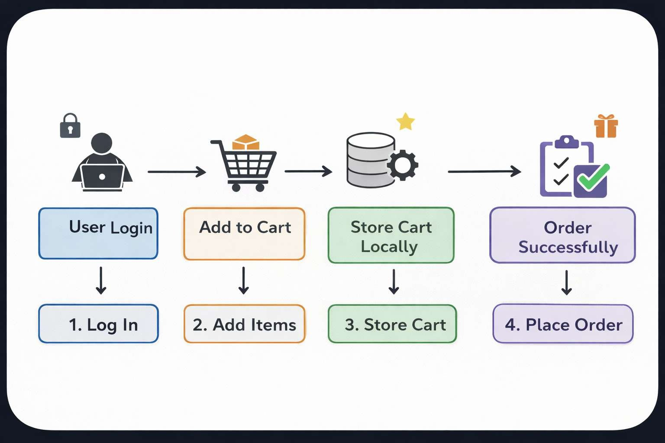
PROPOSED SYSTEM ARCHITECTURE
1
2
3
4
5
6
7
8
9

Slide 7
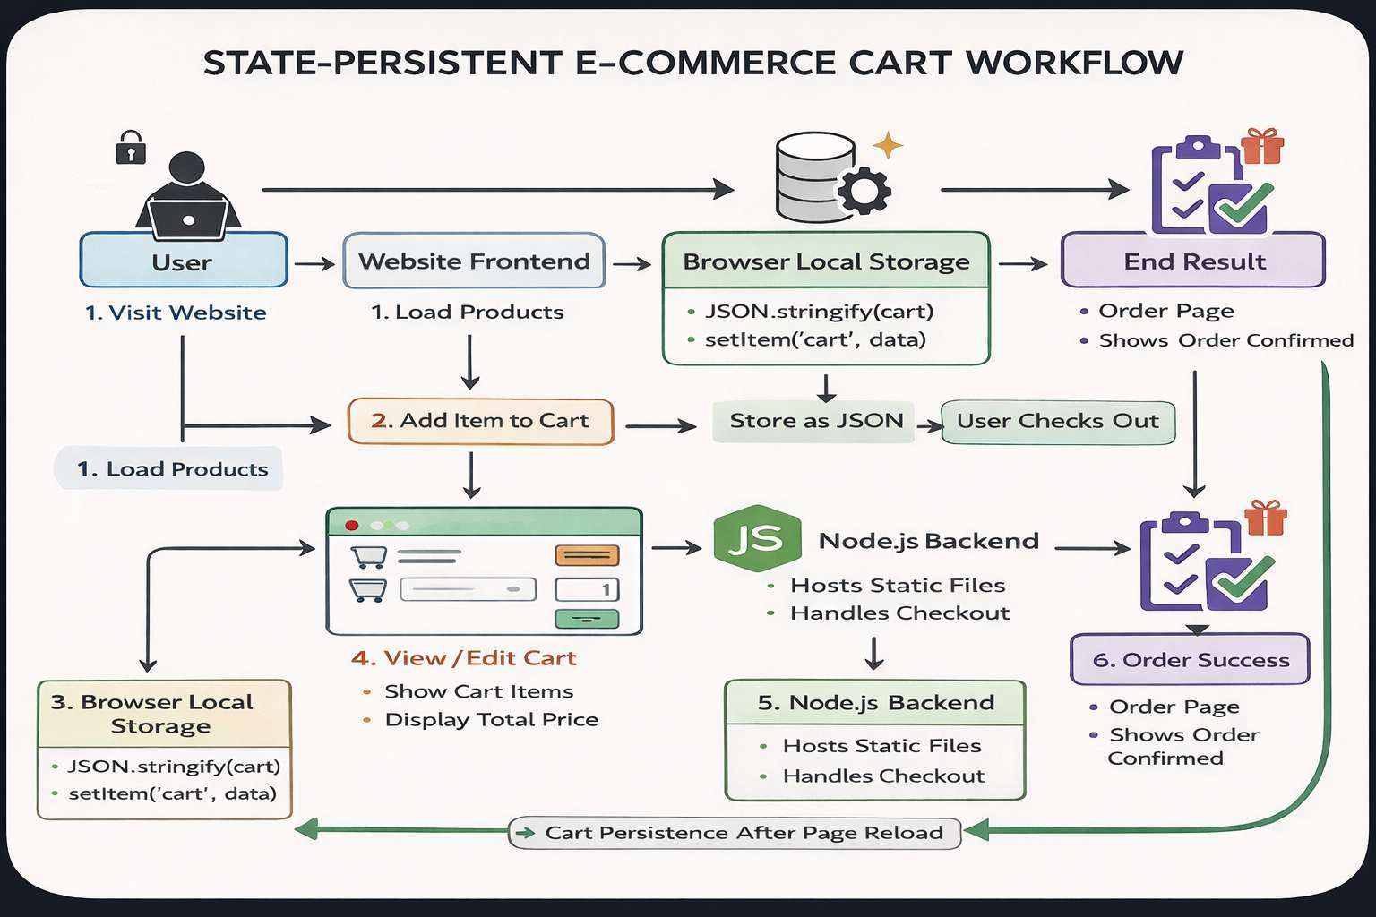
WORKFLOW
Dataflow diagram:
1
2
3
4
5
6
7
8
9

Slide 8
TECHNOLOGIES USED
Frontend:
1
2
HTML5
CSS3
Javascript
3
4
Backend:
5
1.Node.js
6
Tools:
7
1.Visual Studio Code
8
9
Software Requirements:
Windows / Mac
Web Browser

Slide 9

MODULE DESCRIPTION
1
Module 1: Product Management:
2
Display Products Dynamically.
Organizes Products By Category.
3
4
Module 2: Cart Management:
Add To Cart
Remove From Cart
Update Quantity
Calculate Total
5
6
7
Module 3: State Persistence Module:
8
Stores Cart In LocalStorage
Retrieves Data After Referesh.
9
Module 4: Server Module:
Node.js server to host application

Slide 10
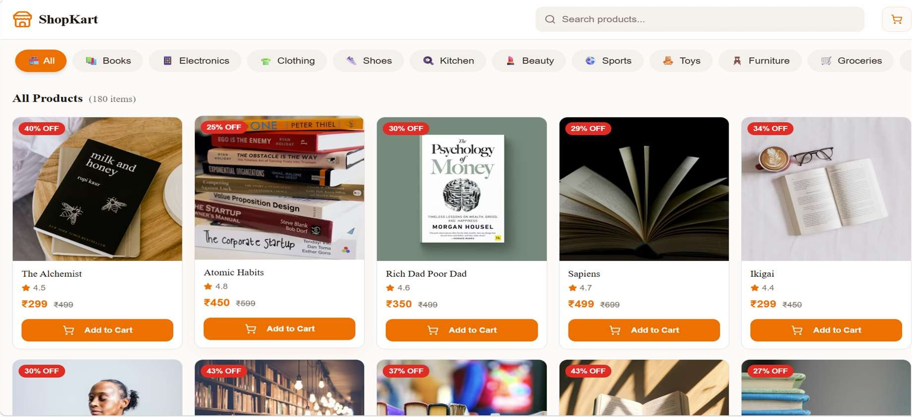
IMPLEMENTATION SCREENSHOTS
Home Page:
1
2
3
4
5
6
7
8
9

Slide 11
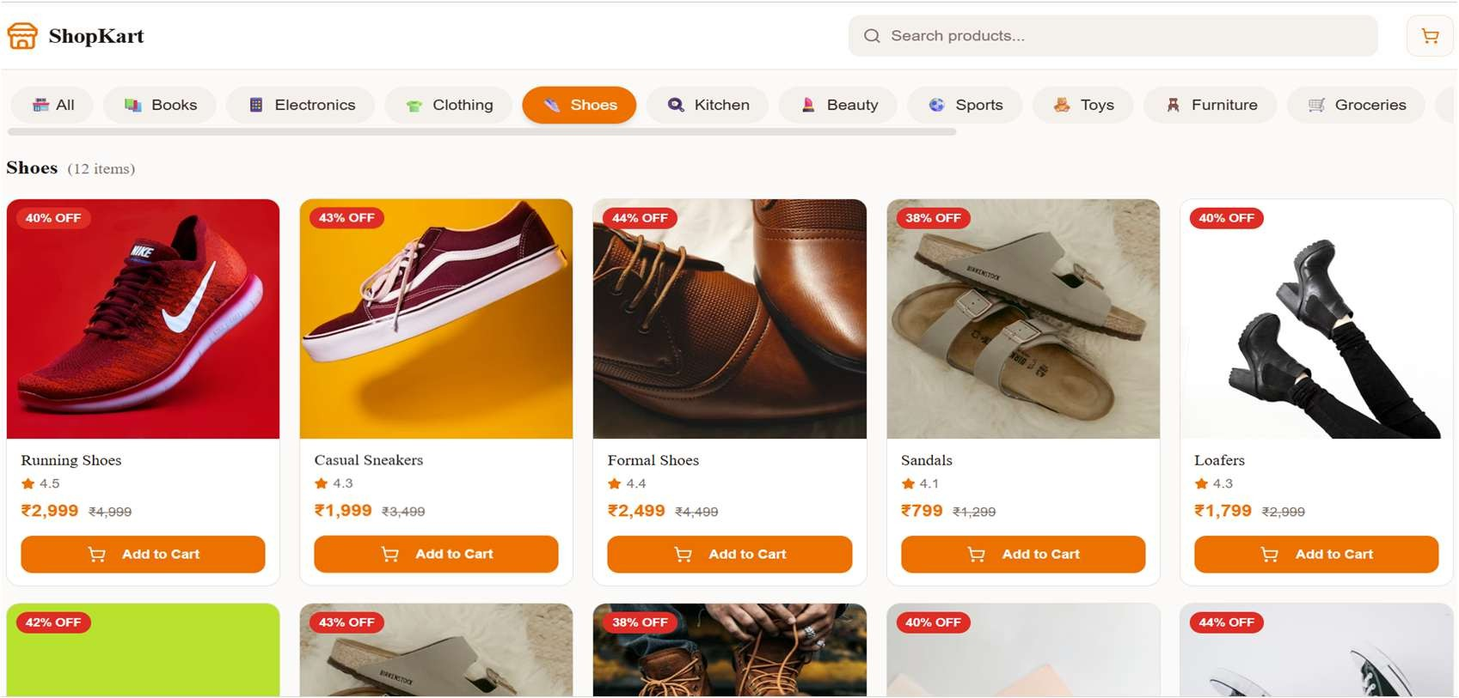
IMPLEMENTATION SCREENSHOTS
Main Page :
1
2
3
4
5
6
7
8(A)
9

Slide 12
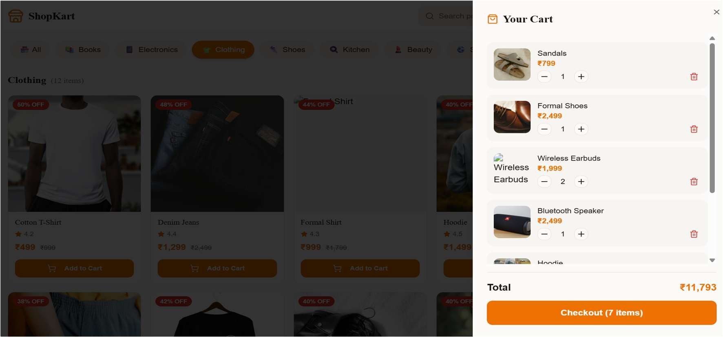
IMPLEMENTATION SCREENSHOTS
1
2
3
4
5
6
7
8(B)
9

Slide 13
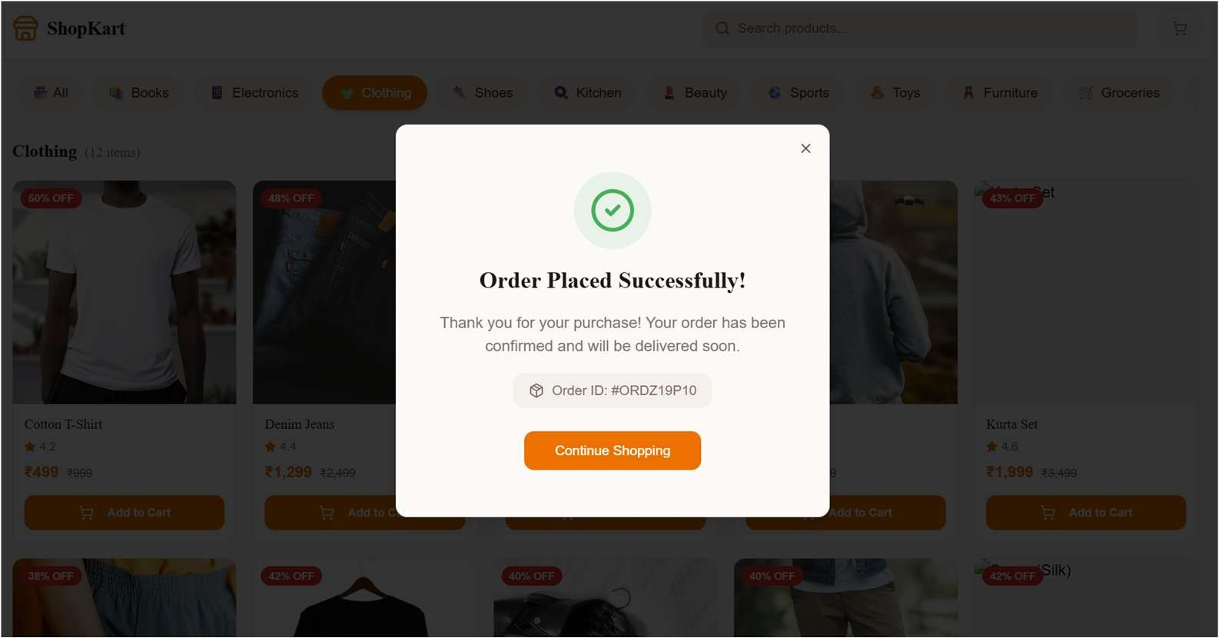
IMPLEMENTATION SCREENSHOTS
1
2
3
4
5
6
7
8(C)
9

Slide 14

ADVANTAGES & LIMITATIONS
1
Advantages:
2
State Persistence using LocalStorage.
Responsive UI design.
Faster cart operations.
Lightweight application.
3
4
5
Limitations:
6
7
No database integration (in current version).
LocalStorage data can be cleared manually.
No payment gateway integration.
Security is limited to client-side validation.
8
9

Slide 15
Thank you

